Slide 1

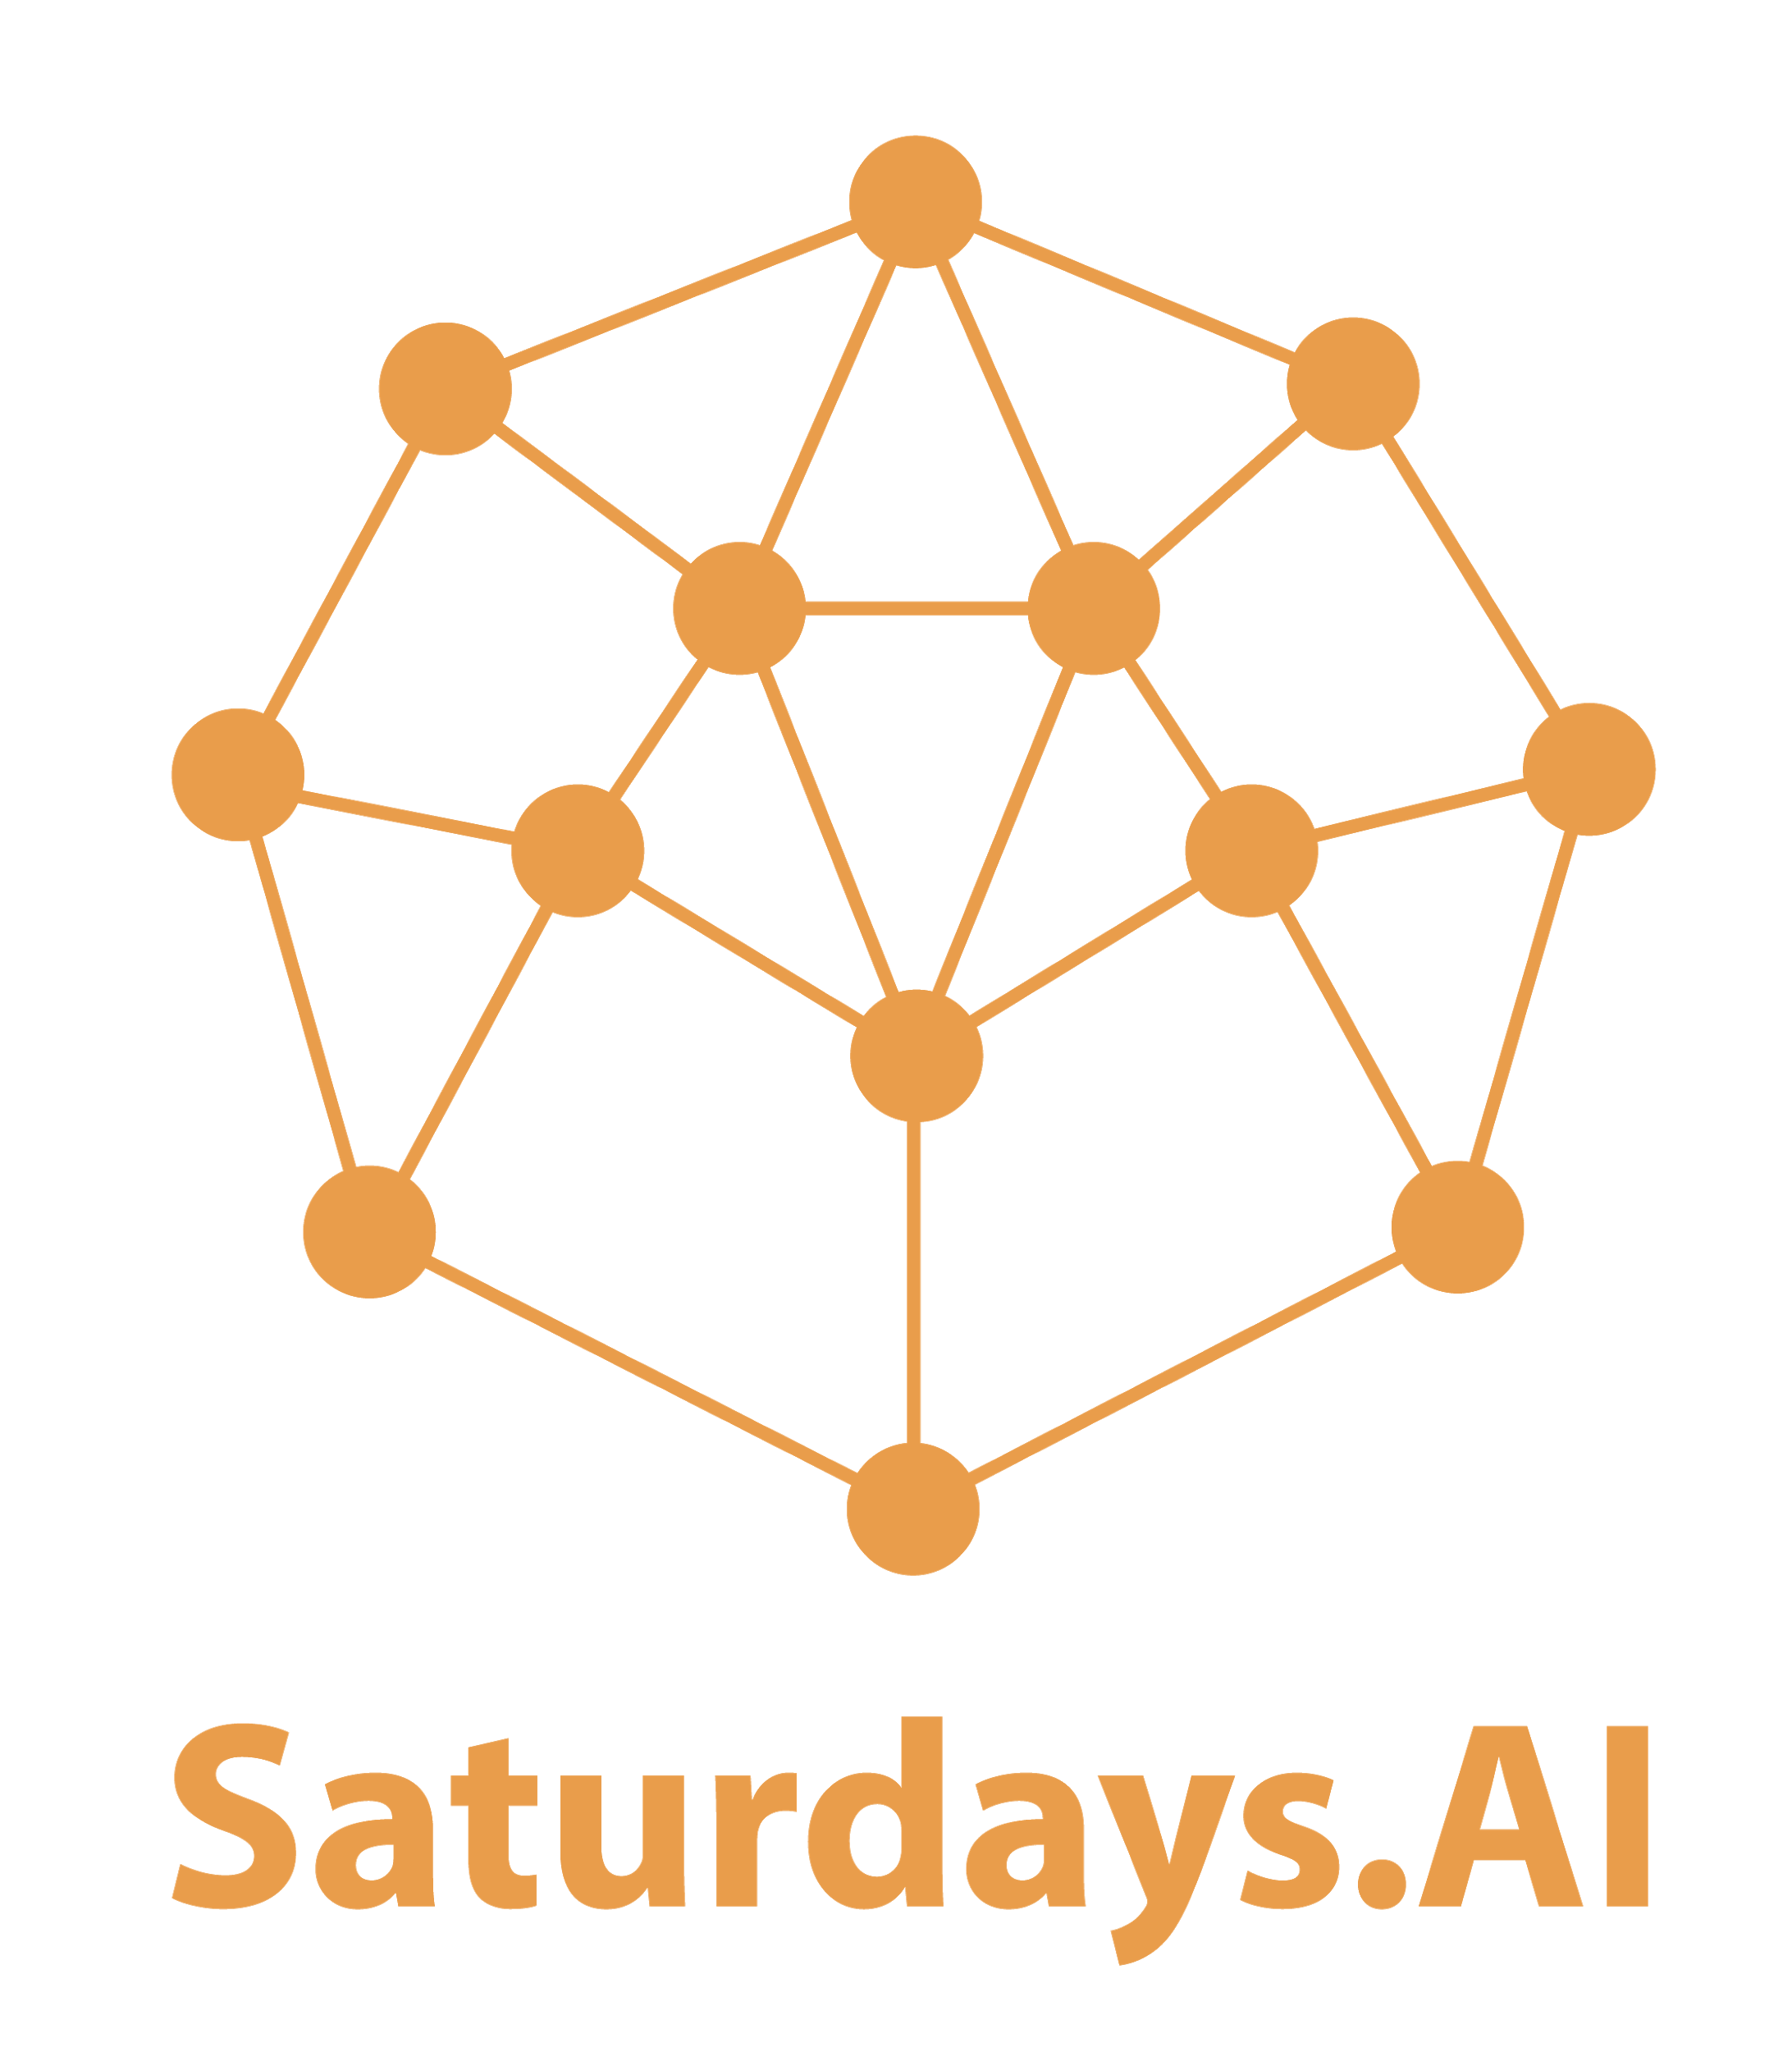
#6 NLP
by Saturdays.AI
Saturdays.AI Madrid
Machine Learning

Slide 2
Week 6
Schedule
State of the course
Session 6 Review
Challenge
Notebook + resources

Slide 3

Session 6
Agenda
01:30 - Lesson #6 + Work!
03:30 - Coffee Break ☕️
03: 45 - Keep Working! 🚀
05:00 - Talk! 🗣

Slide 4
State of the course
#1 Exploratory Data Analysis & Classification ✅
#2 Regression & Model Validation ✅
#3 Random Forest Deep Dive ✅
#4 Unsupervised Learning ✅
#5 Neural Networks, Gradient Descent ✅
#6 NLP 🔴 Today!

Slide 5
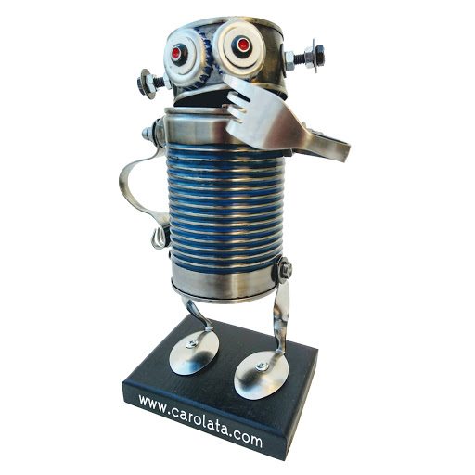
Doubts?

Slide 6
What we are learning?
Lesson 6 NLP
Split
Workflow
Preprocessing
Exploration Classic NLP models Statistical predictions vs. rules
Deep NLP (LSTM, seq2seq, Transformers)
RL, Ontologies, Chatbots...

Slide 7
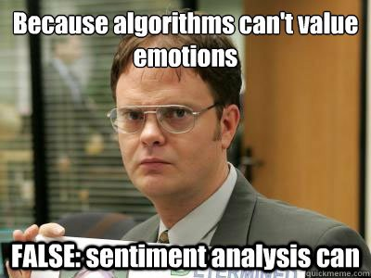

Slide 8
What we are learning?
Scrapping
Data visualization
Encoding (unicode, ascii, byte, etc)
Knowledge graphs
Conversational Agents (chatbots)

Slide 9
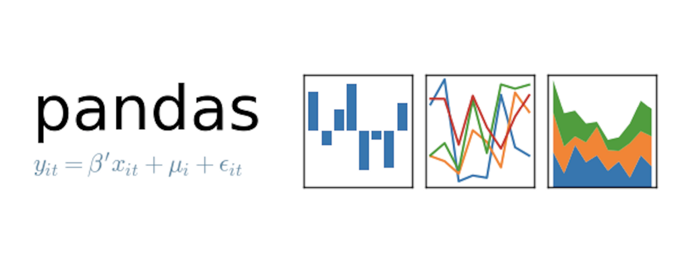



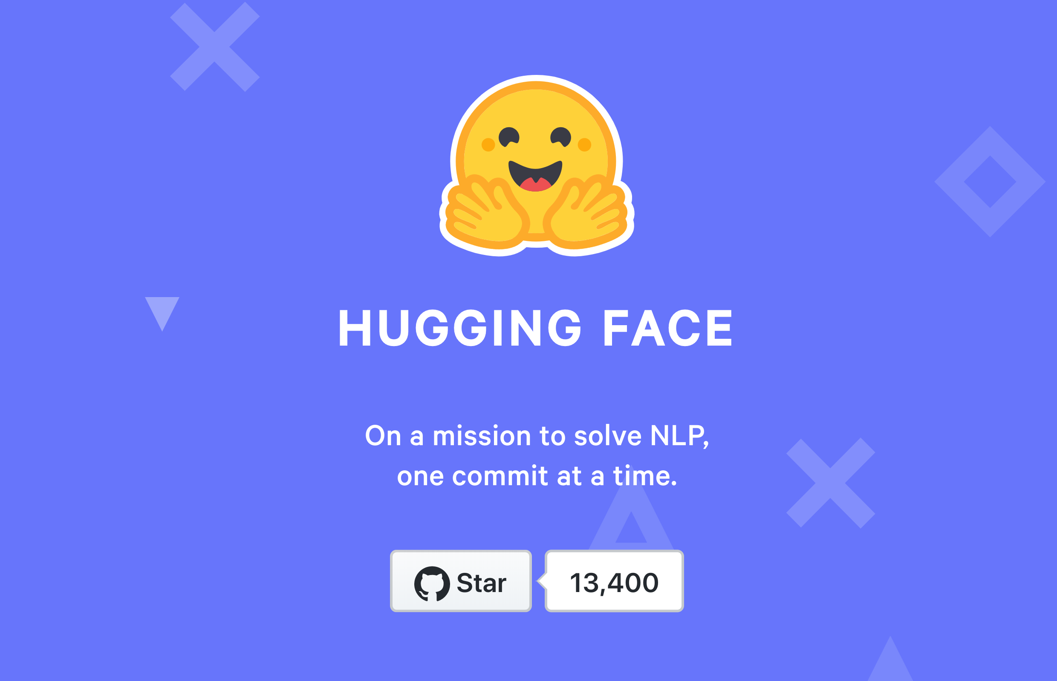

Pandas
Sklearn
spaCy: instalación
Gensim: web
neuralcoref: repo
re (de Python)

Slide 10

Natural Language Processing:
- An area of AI: Linguistics + CS (ML) - Features:
* Ambiguity
* Synonymy
* Syntax
* Correferences / anaphors
* Standardization vs information
* Representation
* Personality/intention/style
Theory to begin with

Slide 11
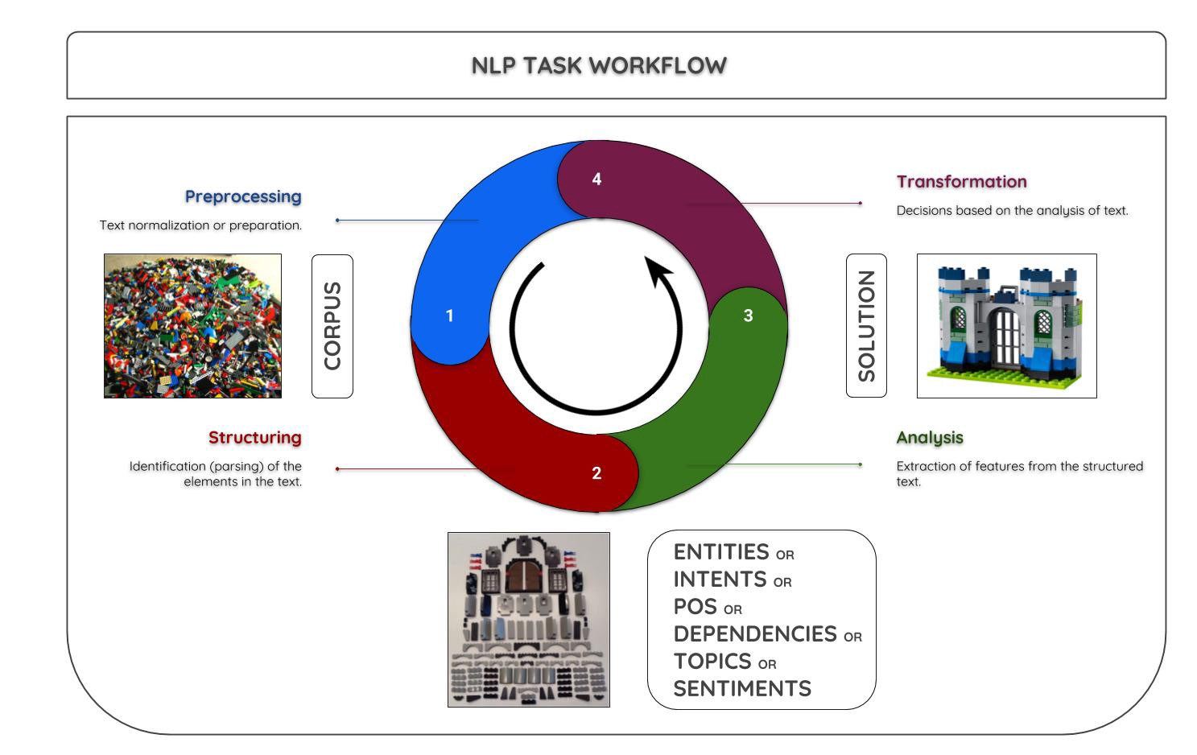

Slide 12

LINK NOTEBOOK DE GOOGLE COLAB

Slide 13
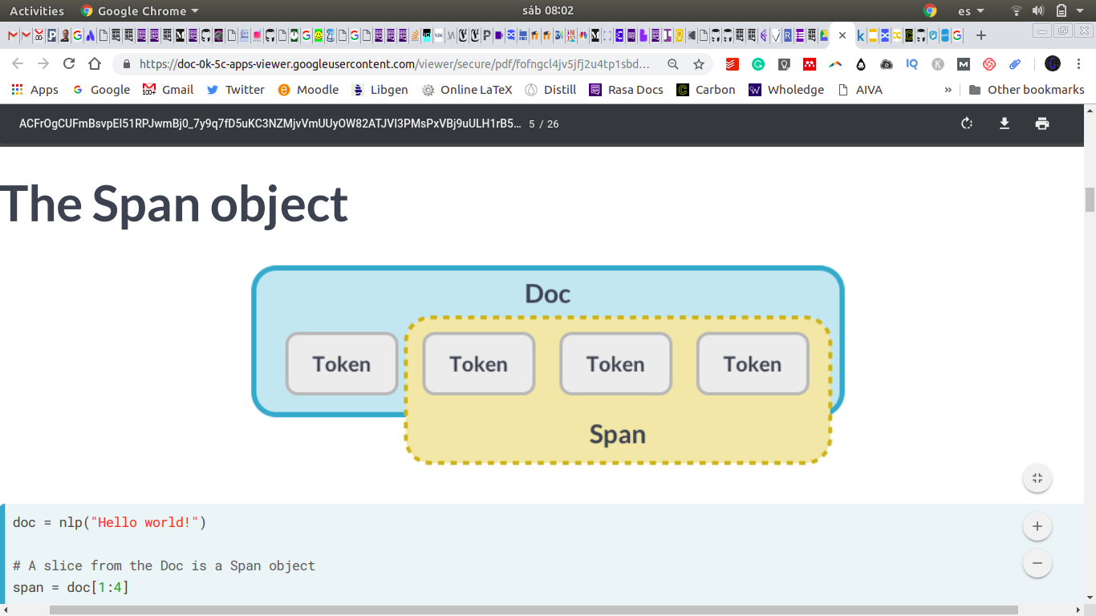
Regex (regular expressions)
Matcher spaCy
Tokenization (con spaCy)
Resource: regex101
Tutorial
Alternative to regex, token matching and attributes. Source

Slide 14
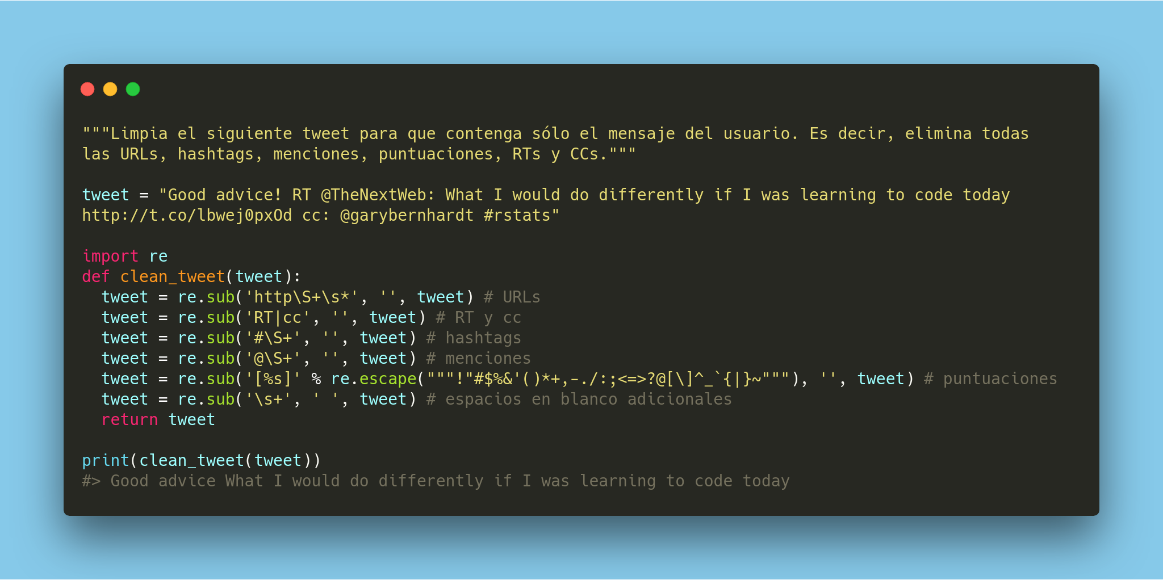

Slide 15
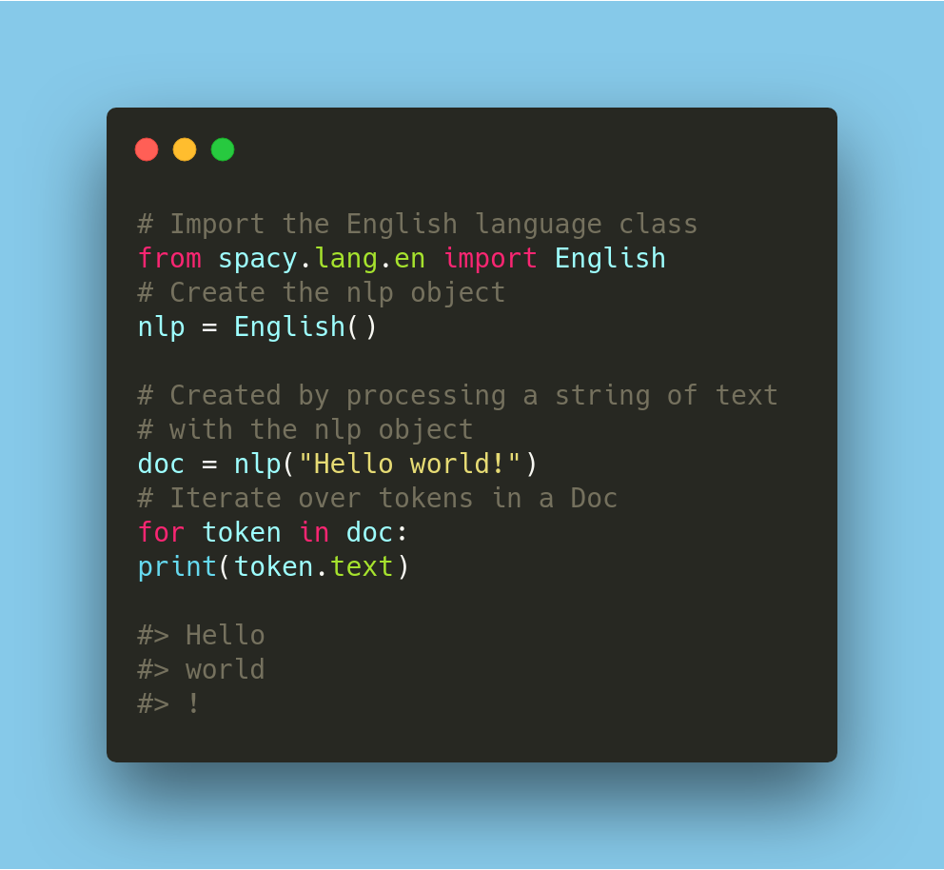
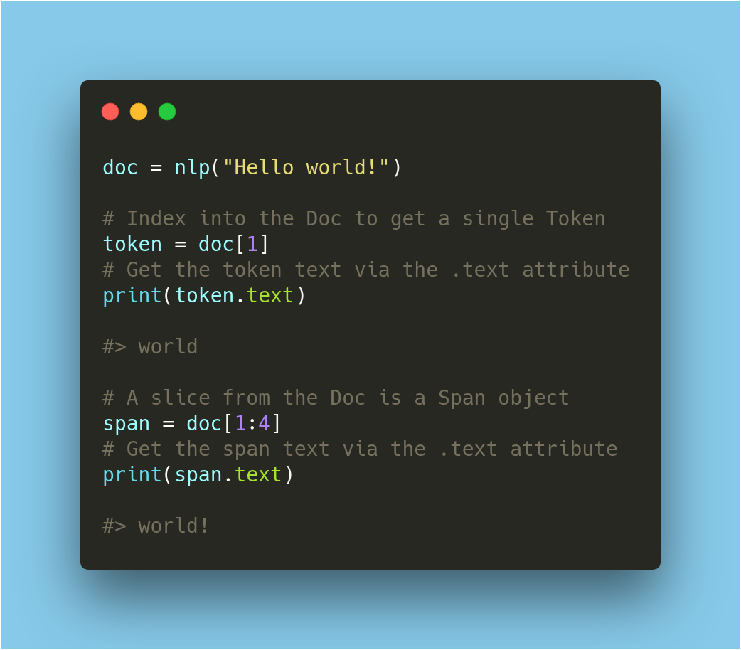

Slide 16
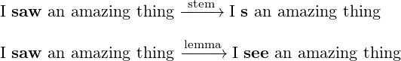
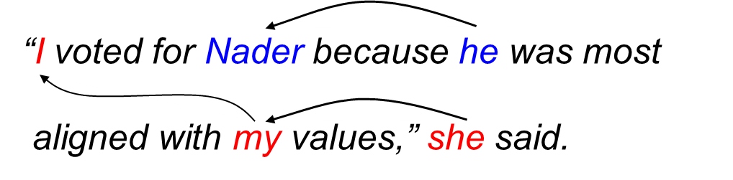
Stemming and lemmatization
Stopwords: terms without intrinsic meaning.
Coreference resolution: huggingface

Slide 17
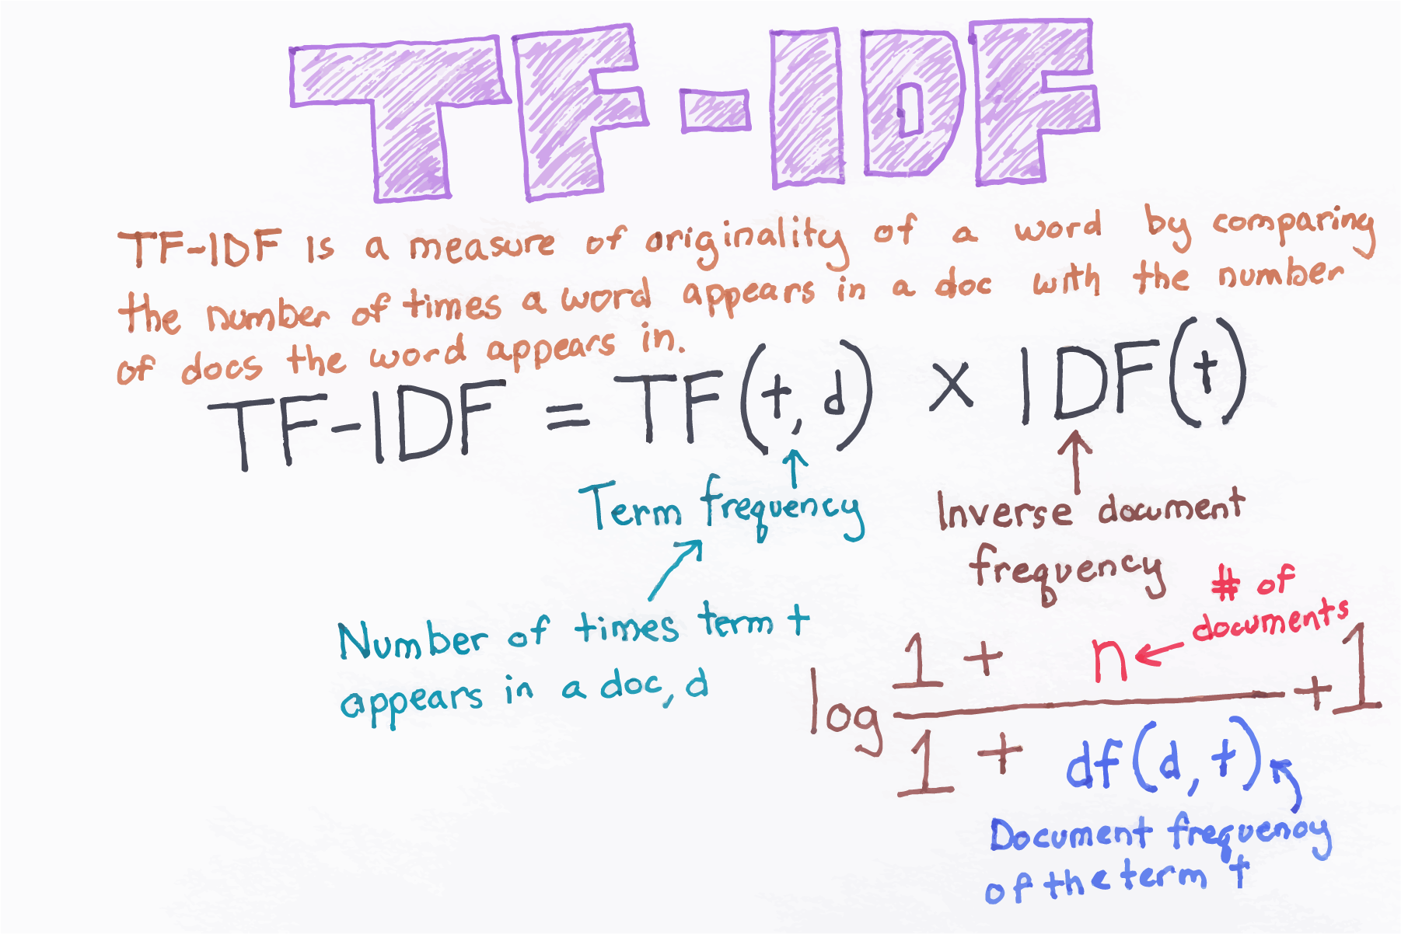
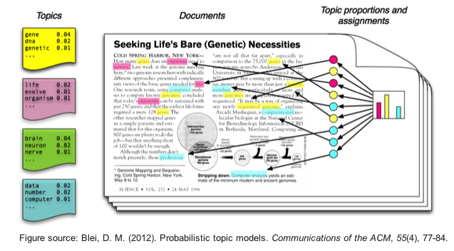
tf-idf
topic modeling

Slide 18
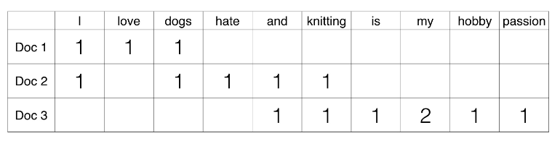
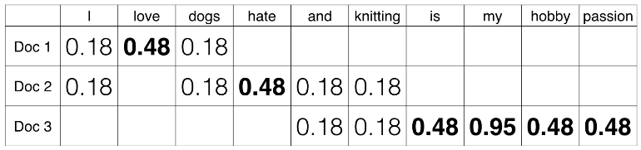
TF-IDF: An Example
I love dogs
I hate dogs and knitting
Knitting is my hobby and my passion

Slide 19
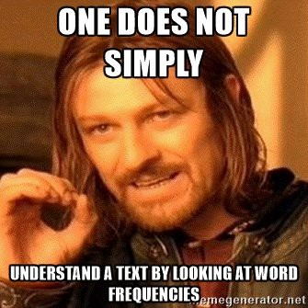

One-hot encoding: sklearn
n-grams
Word embeddings (word2vec, fastText, GloVe)

Slide 20
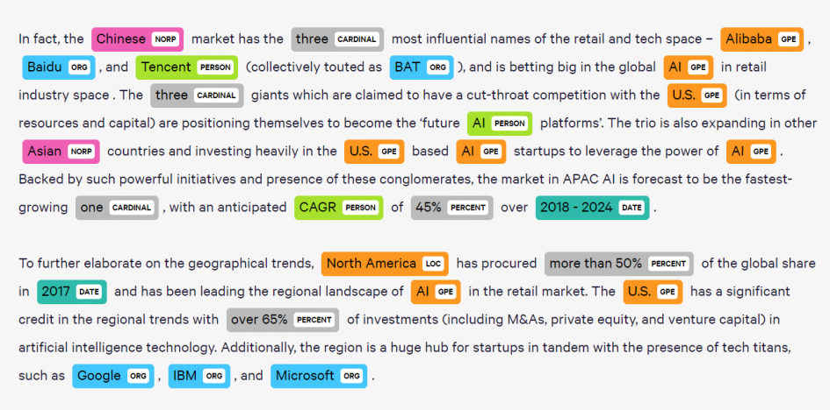
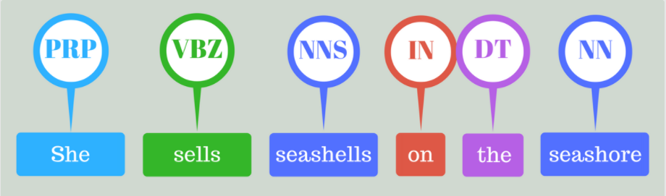
NER
POS tagging
Dependency parsing
Text Classification

Slide 21
 | Statistical models | Rules-based models
Use cases | Your application needs to generalize based on examples | Dictionary with a finite number of examples.
Real examples | Product names, proper names, subject / object relationships | Countries of the world, cities, drug names, dog breeds
spaCy features | Entity recognizer, dependency parser, part-of-speech tagger | Tokenizer, Matcher, PhraseMatcher
Source: Advanced NLP with spaCy

Slide 22
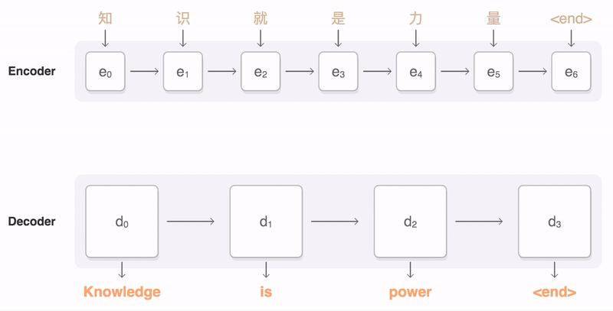
Text Generation
Translation
QnA
Relation Extraction
Error detection & correction

Slide 23
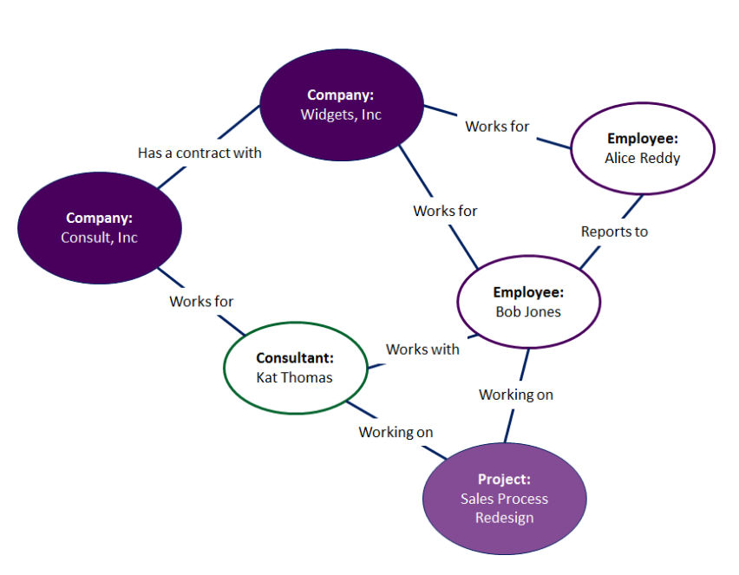
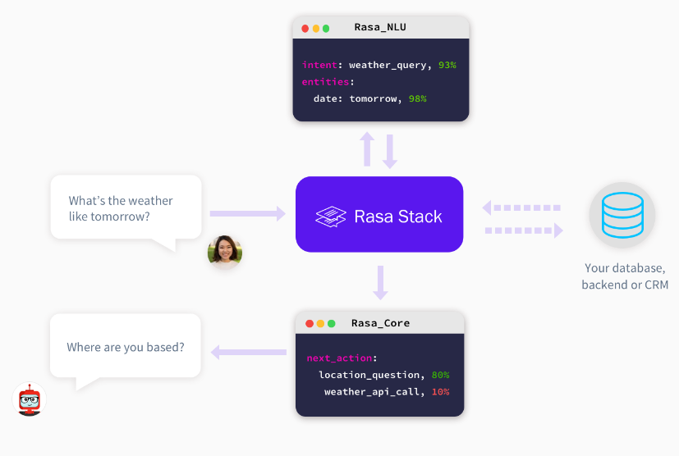
RNN / LSTM / GRU
Autoencoders: Seq2Seq
Further applications: RL for NLP
Chatbots
Knowledge graphs

Slide 24

Challenge!

Slide 25


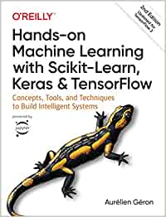


Bibliografía
/1./ /Hands-on Machine Learning with Scikit-Learn, Keras, and TensorFlow/
/2./ /Fast.AI - Introduction to Machine Learning for Coders/
/3./ /MLCourse.AI/
/4./ /DeltaAnalytics/
/5./ /The Hundred-page Machine Learning Book/
/6./ /Machine Learning for Humans (Vishal Maini)/
/7./ /Datacamp/
/8./ /DataQuest/

Slide 26

WI-FI
Wi-Fi
madrid@saturdays.ai

